Slide 1
MGMT 6055 Project Scope & requirements
LAWRENCE KINLIN SCHOOL OF BUSINESS
MODULE 14
Notes:
Used when no picture is available.

Slide 2

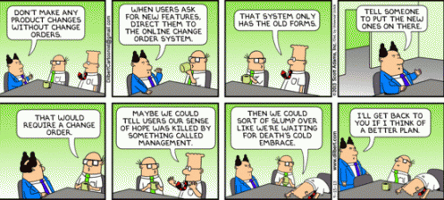
Learning Objectives
Change Management (CM)
Notes:
Dilbert source: http://www.patheos.com/blogs/thoughtfulpastor/2013/09/19/the-freshness-and-fragrance-of-the-gospel-pope-francis-and-the-umc/

Slide 3
Change Management: Organizational or Project?
Organizational change management is a different concept from project change management!
Organizational change: Change of existing organizational policies, procedures, strategies, structures… which have an impact on employees
Usually has a widespread impact across a business unit or the entire organization
Managing employee emotions/motivation is an important element of organizational change management
Project change management: Managing changes within a project
In this course, we focus on project change management

Slide 4
Change Management - PMBOK
Your goal is to maintain the integrity of the project and the project baseline
Remember triple constraints! Change to scope…impacts schedule…impacts budget
A formal and rigorously enforced change control process is mandatory

Slide 5
Examples of Reasons for Project Changes
Change is inevitable in projects – sometimes for good reasons, sometimes for not-so-good reasons
Business needs have changed
Organization structure has changed
Technology has improved
Strategic priorities have changed
Supply chains/business partners have changed
Client requests
New legislation/regulations
Other projects have changed (that affect your project)
We made planning/design mistakes
Notes:
Source: adapted from http://www.epmbook.com/scope.htm

Slide 6
Change Management
“Very often it is a large number of small scope changes that do the damage, rather than big, obvious ones.” (http://www.epmbook.com/scope.htm)

Slide 7
Change Management
“Watch out for the use of scope change as an aggressive behaviour. Sub-contractors may intentionally try to expand the size of their contract by establishing scope changes that lead them to do additional work outside of the original agreement. Some contractors under-bid the cost of the work to gain the contract, in the belief that they will be able to make their profit out of scope changes.” (http://www.epmbook.com/scope.htm)

Slide 8
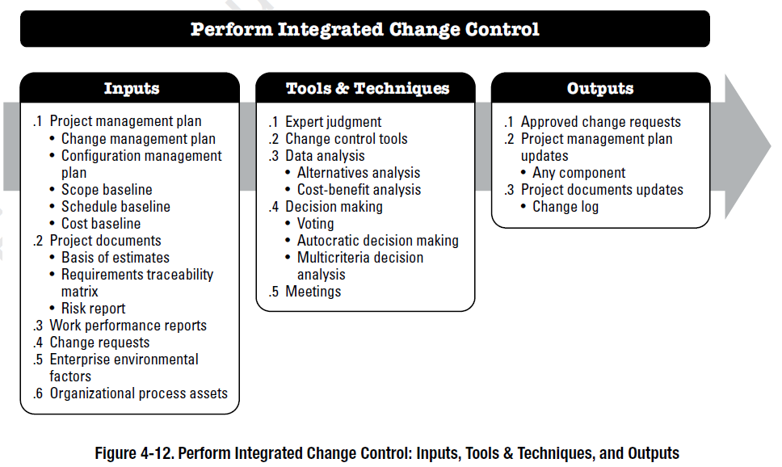
Change Management – PMBOK

Slide 9
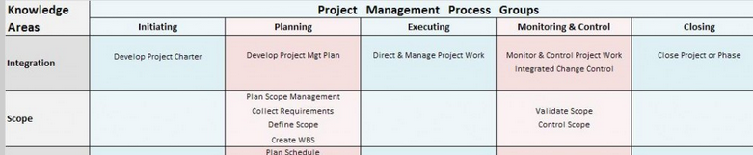
Change Management - PMBOK
Perform Integrated Change Control is the PMBOK process associated with Project Change Management
Perform Integrated Change Control is NOT a process in the Project Scope Management knowledge area
Why not?
Because change can affect any aspect of a project – scope, time, cost, quality, human resources, communications, risk, procurement, stakeholder management, project plans, etc….

Slide 10
Change Management - Inputs
Project Management Plan – Includes the change request process, the baseline, etc.
Project Documents – Basis of estimate, requirements traceability matrix, risk reports
Work Performance Reports – Supplemental information to describe the context for the change, or the current status of the project
Change Requests – Anyone can submit a change request (e.g., client, team member) – see examples below
Enterprise Environmental Factors – E.g., external organizational factors that might explain the reason for the proposed change
Organizational Process Assets – E.g., Standard change control procedures used within the organization

Slide 11
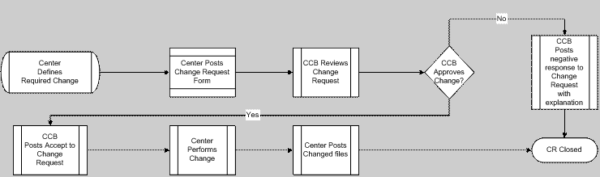
Example of a Change Request Process
CCB = Change Control Board
Notes:
Source: https://ca.images.search.yahoo.com/images/view;_ylt=A2KLj9M3_2FWJS4ACUY.7olQ;_ylu=X3oDMTIyMXBnazJlBHNlYwNzcgRzbGsDaW1nBG9pZAMyNTU5ZTJmNWYyMDM2ZDYyZjkwOGI3NWJmY2M4NmI2MwRncG9zAzEEaXQDYmluZw--?.origin=&back=https%3A%2F%2Fca.images.search.yahoo.com%2Fyhs%2Fsearch%3Fp%3Dchange%2Brequest%2Bprocess%2Bccb%26fr2%3Dpiv-web%26hsimp%3Dyhs-rogers_001%26hspart%3Drogers%26tab%3Dorganic%26ri%3D1&w=706&h=594&imgurl=www.fdicoig.gov%2Freports05%2F05-022%2F05-022-508-CDR_image.jpg&rurl=http%3A%2F%2Fwww.fdicoig.gov%2Freports05%2F05-022-508.shtml&size=75.9KB&name=cr+%3Cb%3Echange%3C%2Fb%3E+%3Cb%3Erequest%3C%2Fb%3E+%3Cb%3Eccb%3C%2Fb%3E+%3Cb%3Echange+control+board%3C%2Fb%3E+pm+project+manager+sc+...&p=change+request+process+ccb&oid=2559e2f5f2036d62f908b75bfcc86b63&fr2=piv-web&fr=&tt=cr+%3Cb%3Echange%3C%2Fb%3E+%3Cb%3Erequest%3C%2Fb%3E+%3Cb%3Eccb%3C%2Fb%3E+%3Cb%3Echange+control+board%3C%2Fb%3E+pm+project+manager+sc+...&b=0&ni=21&no=1&ts=&tab=organic&sigr=11hup8l0m&sigb=14av3s45s&sigi=11pssrt0d&sigt=130hr71vl&sign=130hr71vl&.crumb=lPN8dUzLlJS&fr2=piv-web&hsimp=yhs-rogers_001&hspart=rogers

Slide 12
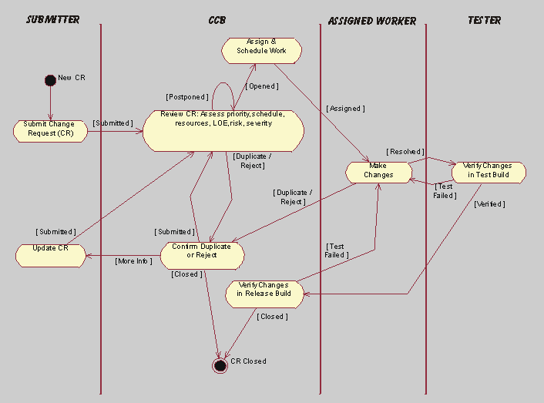
Another Example of a Change Request Process
Notes:
Source: https://ca.images.search.yahoo.com/images/view;_ylt=A2KLj9M3_2FWJS4ACUY.7olQ;_ylu=X3oDMTIyMXBnazJlBHNlYwNzcgRzbGsDaW1nBG9pZAMyNTU5ZTJmNWYyMDM2ZDYyZjkwOGI3NWJmY2M4NmI2MwRncG9zAzEEaXQDYmluZw--?.origin=&back=https%3A%2F%2Fca.images.search.yahoo.com%2Fyhs%2Fsearch%3Fp%3Dchange%2Brequest%2Bprocess%2Bccb%26fr2%3Dpiv-web%26hsimp%3Dyhs-rogers_001%26hspart%3Drogers%26tab%3Dorganic%26ri%3D1&w=706&h=594&imgurl=www.fdicoig.gov%2Freports05%2F05-022%2F05-022-508-CDR_image.jpg&rurl=http%3A%2F%2Fwww.fdicoig.gov%2Freports05%2F05-022-508.shtml&size=75.9KB&name=cr+%3Cb%3Echange%3C%2Fb%3E+%3Cb%3Erequest%3C%2Fb%3E+%3Cb%3Eccb%3C%2Fb%3E+%3Cb%3Echange+control+board%3C%2Fb%3E+pm+project+manager+sc+...&p=change+request+process+ccb&oid=2559e2f5f2036d62f908b75bfcc86b63&fr2=piv-web&fr=&tt=cr+%3Cb%3Echange%3C%2Fb%3E+%3Cb%3Erequest%3C%2Fb%3E+%3Cb%3Eccb%3C%2Fb%3E+%3Cb%3Echange+control+board%3C%2Fb%3E+pm+project+manager+sc+...&b=0&ni=21&no=1&ts=&tab=organic&sigr=11hup8l0m&sigb=14av3s45s&sigi=11pssrt0d&sigt=130hr71vl&sign=130hr71vl&.crumb=lPN8dUzLlJS&fr2=piv-web&hsimp=yhs-rogers_001&hspart=rogers

Slide 13
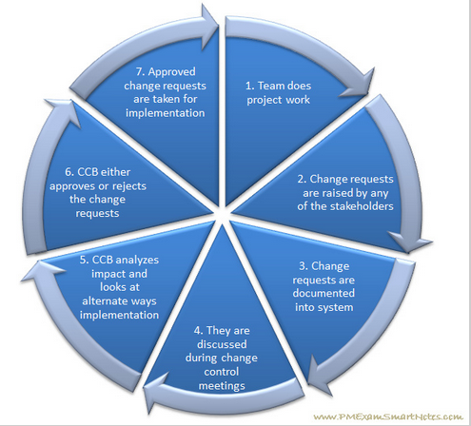
Summary of Elements Commonly Found in Change Request Processes
In well-run projects, this process is formalized:
Change request procedures are planned and documented before project execution
Procedures are followed during project execution
Notes:
https://ca.images.search.yahoo.com/images/view;_ylt=A2KLj9M3_2FWJS4ACUY.7olQ;_ylu=X3oDMTIyMXBnazJlBHNlYwNzcgRzbGsDaW1nBG9pZAMyNTU5ZTJmNWYyMDM2ZDYyZjkwOGI3NWJmY2M4NmI2MwRncG9zAzEEaXQDYmluZw--?.origin=&back=https%3A%2F%2Fca.images.search.yahoo.com%2Fyhs%2Fsearch%3Fp%3Dchange%2Brequest%2Bprocess%2Bccb%26fr2%3Dpiv-web%26hsimp%3Dyhs-rogers_001%26hspart%3Drogers%26tab%3Dorganic%26ri%3D1&w=706&h=594&imgurl=www.fdicoig.gov%2Freports05%2F05-022%2F05-022-508-CDR_image.jpg&rurl=http%3A%2F%2Fwww.fdicoig.gov%2Freports05%2F05-022-508.shtml&size=75.9KB&name=cr+%3Cb%3Echange%3C%2Fb%3E+%3Cb%3Erequest%3C%2Fb%3E+%3Cb%3Eccb%3C%2Fb%3E+%3Cb%3Echange+control+board%3C%2Fb%3E+pm+project+manager+sc+...&p=change+request+process+ccb&oid=2559e2f5f2036d62f908b75bfcc86b63&fr2=piv-web&fr=&tt=cr+%3Cb%3Echange%3C%2Fb%3E+%3Cb%3Erequest%3C%2Fb%3E+%3Cb%3Eccb%3C%2Fb%3E+%3Cb%3Echange+control+board%3C%2Fb%3E+pm+project+manager+sc+...&b=0&ni=21&no=1&ts=&tab=organic&sigr=11hup8l0m&sigb=14av3s45s&sigi=11pssrt0d&sigt=130hr71vl&sign=130hr71vl&.crumb=lPN8dUzLlJS&fr2=piv-web&hsimp=yhs-rogers_001&hspart=rogers

Slide 14
Change Control Boards
The idea is to make key decisions about change requests on the project. These change requests can be submitted by the Client, but also by the Sponsor or Project Team, if something set up at the initiating phase of the project now requires to be changed.
The CCB will analyze and review the change requests submitted and make a decision whether to accept or reject them.

Slide 15
Change Control Boards
In small projects, the Project Manager may make sole decisions about approving/denying changes
In larger projects, Change Control Boards (CCBs) are committees that are established to make decisions about project changes
Who sits on a Change Control Board? This is determined during the project planning stage and may include:
Sponsor
Senior Management
Client Representatives
PMO Representatives
Project Manager
Key team members
Key suppliers
Other stakeholders

Slide 16
Change Management – T/T
Expert judgement
Change control tools (e.g., using change process flow charts, change request software)
Data analysis (alternatives, cost-benefit analysis)
Decision making (voting, multi-criteria decision-making, etc.)
Meetings

Slide 17
Change Management - PMBOK
Before deciding to approve or reject a proposed change, the Project Manager or CCB must determine is the impact of the change on the project:
More resources required ?
Schedule changes ?
Changes to product features ?
Changes to the budget ?
Changes to project risks ?
Impact on existing contracts (e.g., supply contracts)?
Impact to the project baseline ?

Slide 18
Change Management – Outputs
Approved change requests
Project management plan updates – if an update to the change management process is needed
Project document updates – e.g., budgets, schedules, requirements documents, change logs (see below)

Slide 19
Change Management - PMBOK
Change requests can include corrective action, preventive action and defect repairs
The change request document is an important tool for change management

Slide 20
Video Clip
Video: Managing Change – How to Manage Project Change https://www.youtube.com/watch?v=tMR7jVefRIQ (note: In this video, the presenter mentions the Statement of Work, but in our course (and PMBOK), we would refer to the Scope Statement) (6 min)
Have you heard the saying: “It’s easier to beg for forgiveness than ask for permission”? When it comes to project management, it’s MUCH better to ask for permission than beg for forgiveness! (You might not get forgiveness, you probably won’t get paid, and you might possibly even get fired.)

